Slide 1
WHY
we do, WHAT we do?
-MANSI BREJA

Slide 2
WEBINAR SERIES
WORDS IN WORTH_LIVE

Slide 3
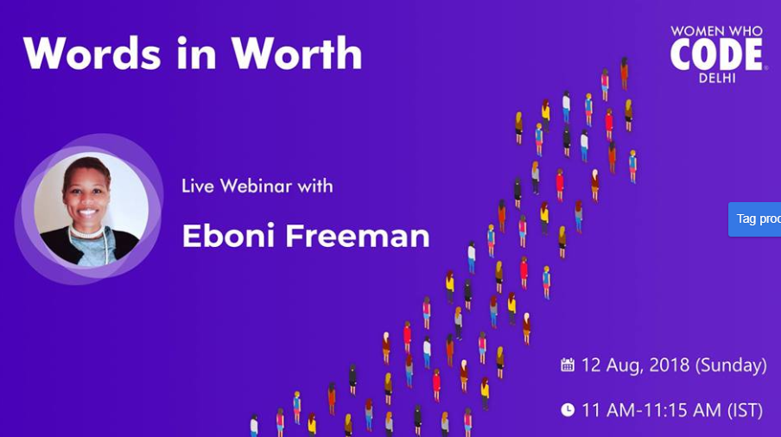
EBONI FREEMAN
Eboni is a supernova of courage. At 16 when most teens are busy planning their career, she was diagnosed with a disability which for her meant literally that anyday on earth could be her last. What inspires me is instead of letting it pull her back, she rather used it an instrument to become the voice for many black women and is now motivating a number of disabled people in pursuing their dreams.
Today, she is the CEO of a US based startup called Ability Enabled, an Incoming Associate Account Strategist at Google and was selected as 1 of 5 'up and coming' female tech interns to speak at the conference for 150+ undergraduate and high school young women interested in STEM by twitter.

Slide 4
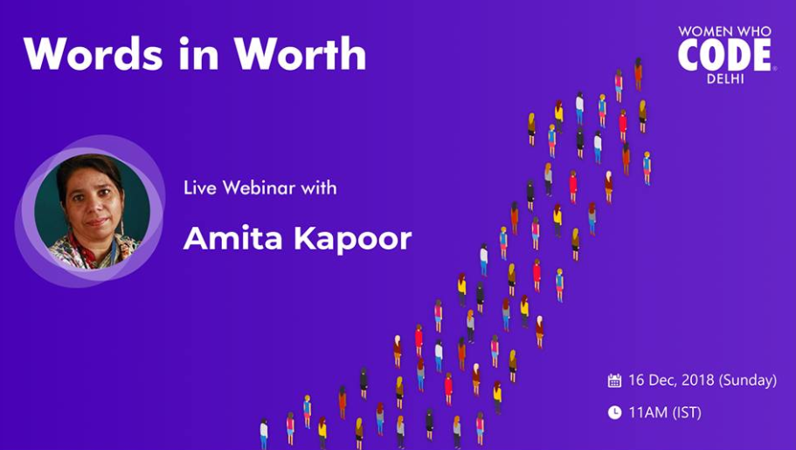
AMITA KAPOOR
In the year 1994, when she first studied neural networks as part of her undergraduate course, she instantly fell in love with them. The love sustained through the AI winters, first at IIT Delhi, where she worked on Knowledge Representation and Expert Systems. And later through her job duration where along with many other papers she got to teach Neural Networks and Artificial Intelligence to undergraduate students.
In 2013, taking advantage of changing educational landscape, she relearned from the masters in AI/ML. Five years along the line, today she has many AI projects, research papers and some amazing books under her name.

Slide 5
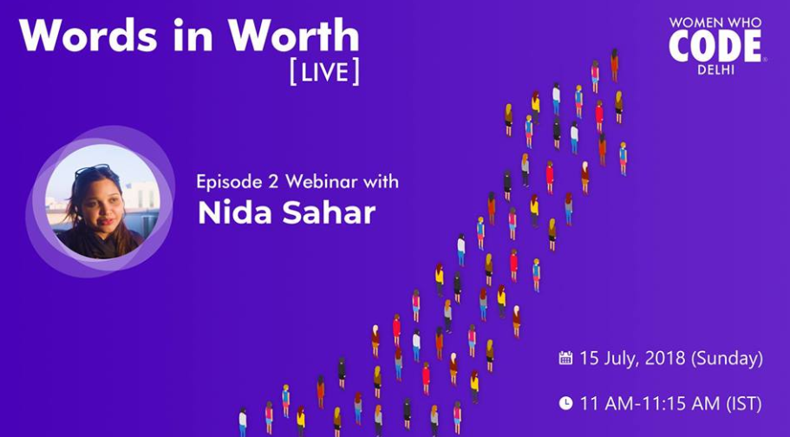
NIDA SAHAR
Nida is the CTO at Piggeybanc, PR Manager at Lean In India and has been a mentor at other various leading organizations like Hexagon UX. She’s worked with some of the top names in the industry including HP, Oracle, Dell EMC among others and today is one leading voices in technology in India inspiring hundreds in her footsteps.
...Then he asked me , "What about you?" . I think I was about 20/21 years old that time. So I told him that I had no inclination towards this and probably would get married by that time, and then whether I study or not then would depend on where I get married. Now, this was actually the Life Changing Situation for me. My friend paused for a minute and then literally scolded me horribly saying things like: "You wasted an engineering seat!"

Slide 6
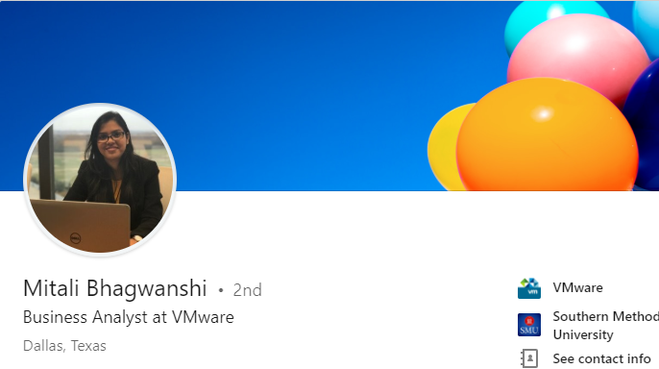
OUR NEXT GUEST
MITALI BHAGWANSHI
Take charge, change the situation...
Stop blaming people, even in difficult times...
Accept hardships, otherwise the appreciation for good times won’t come

Slide 7
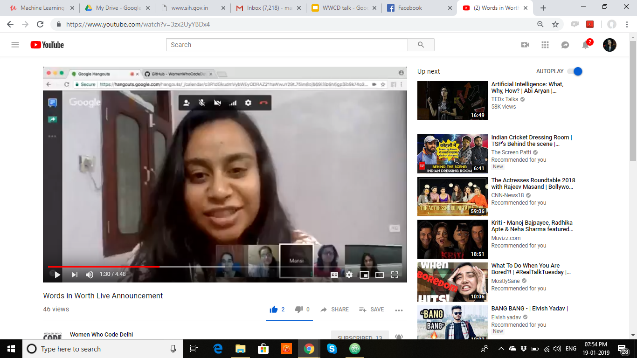
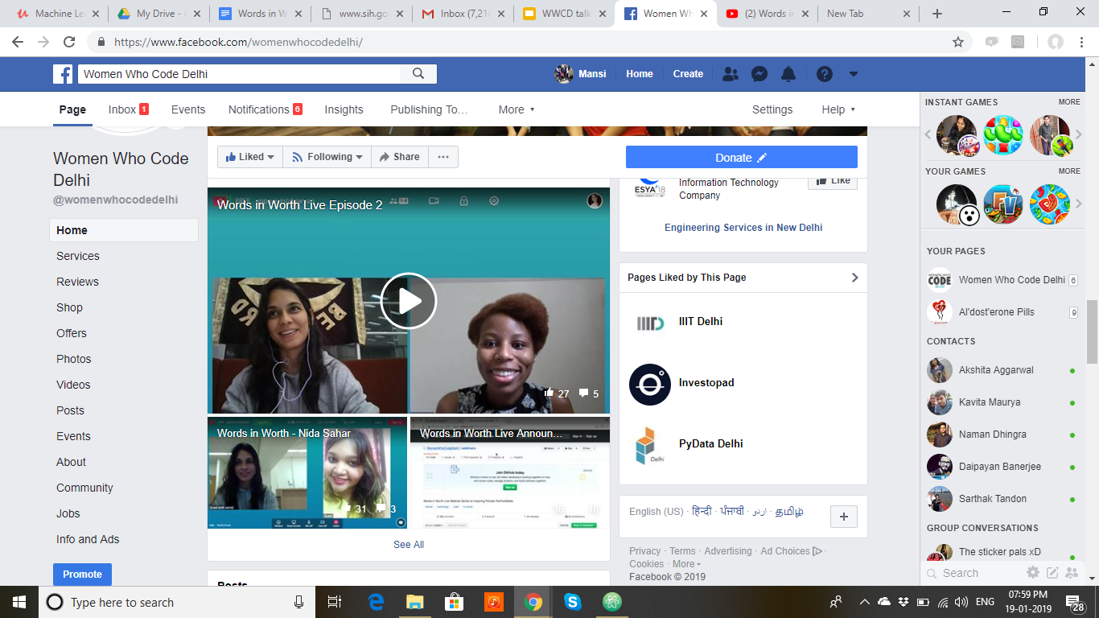
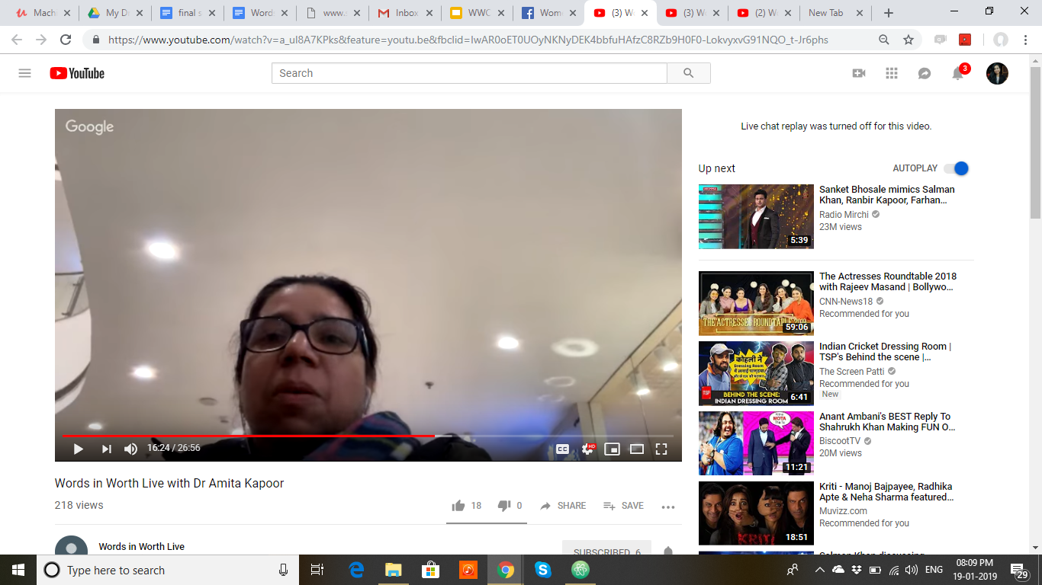
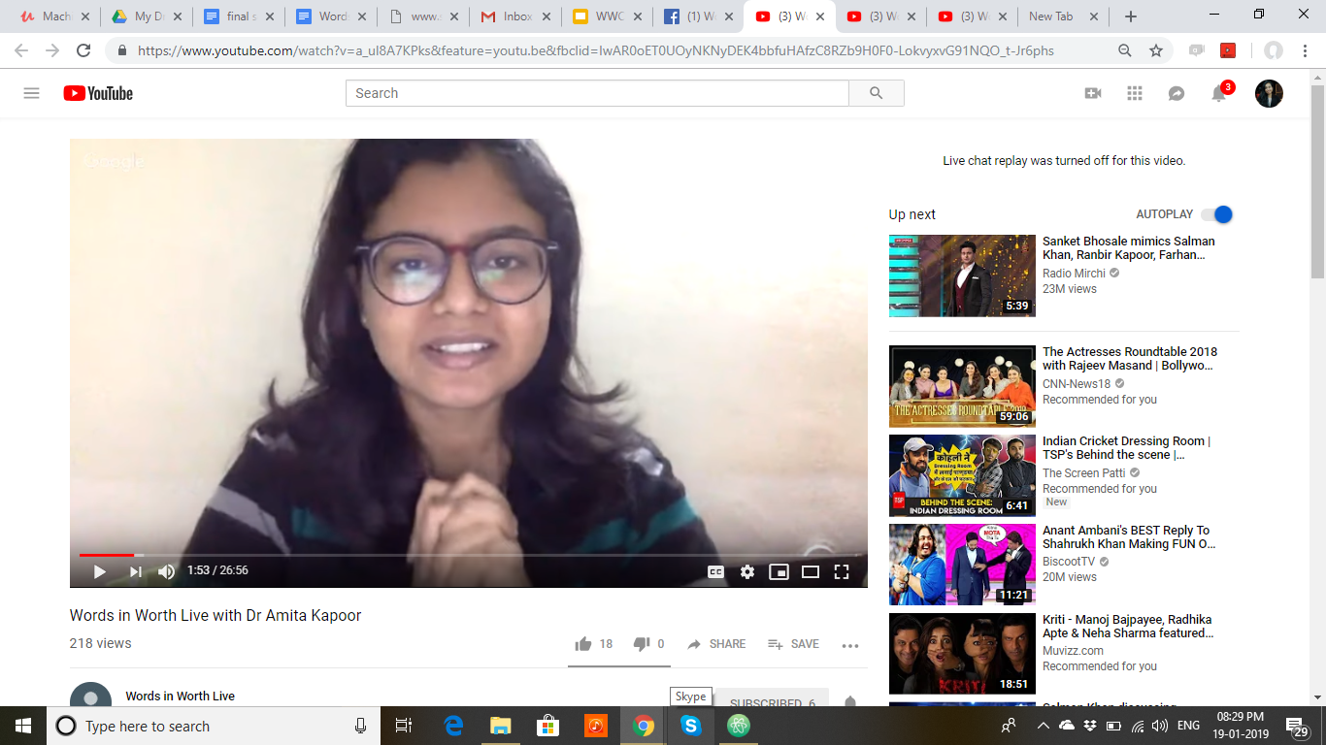
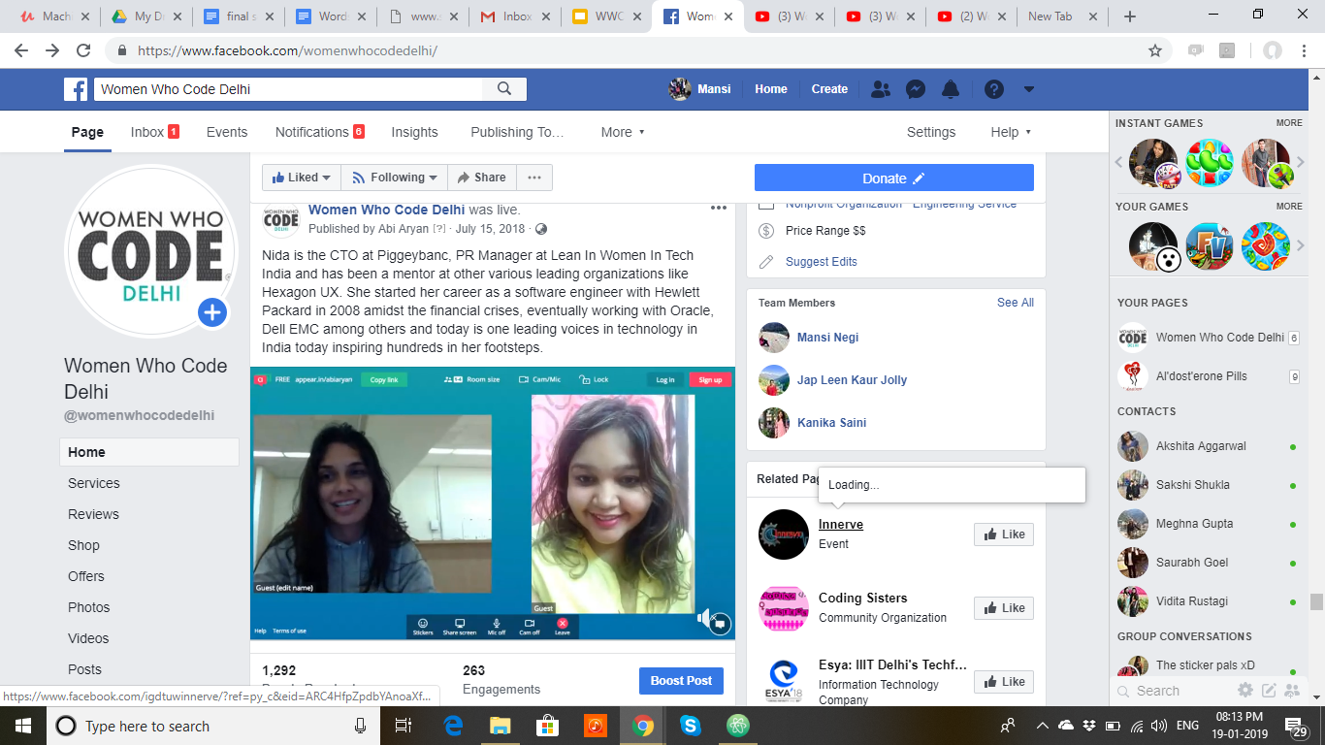
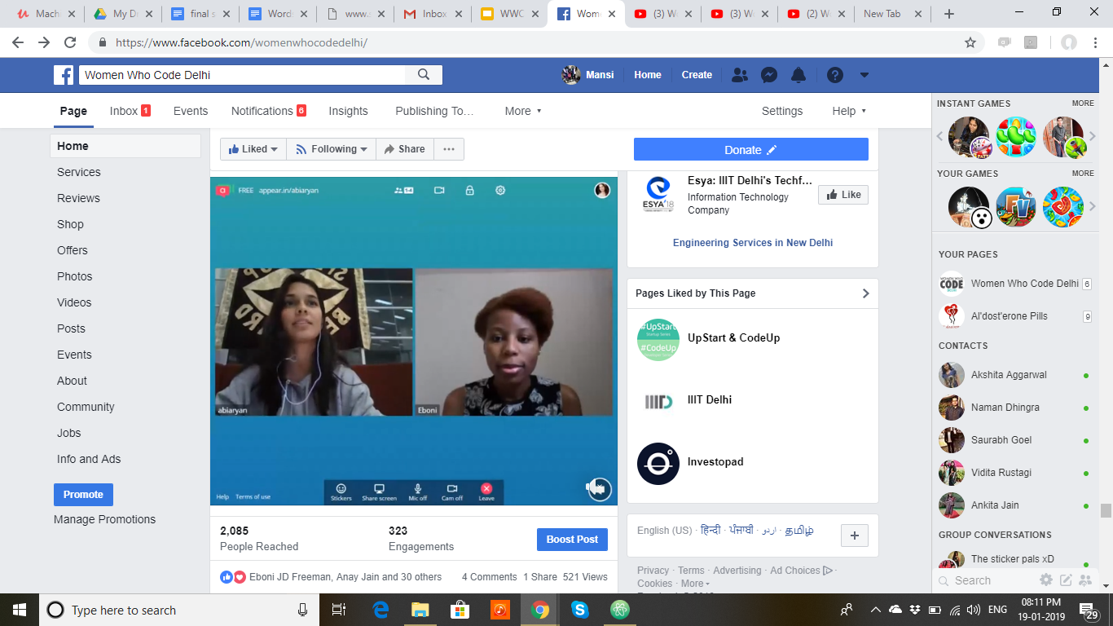
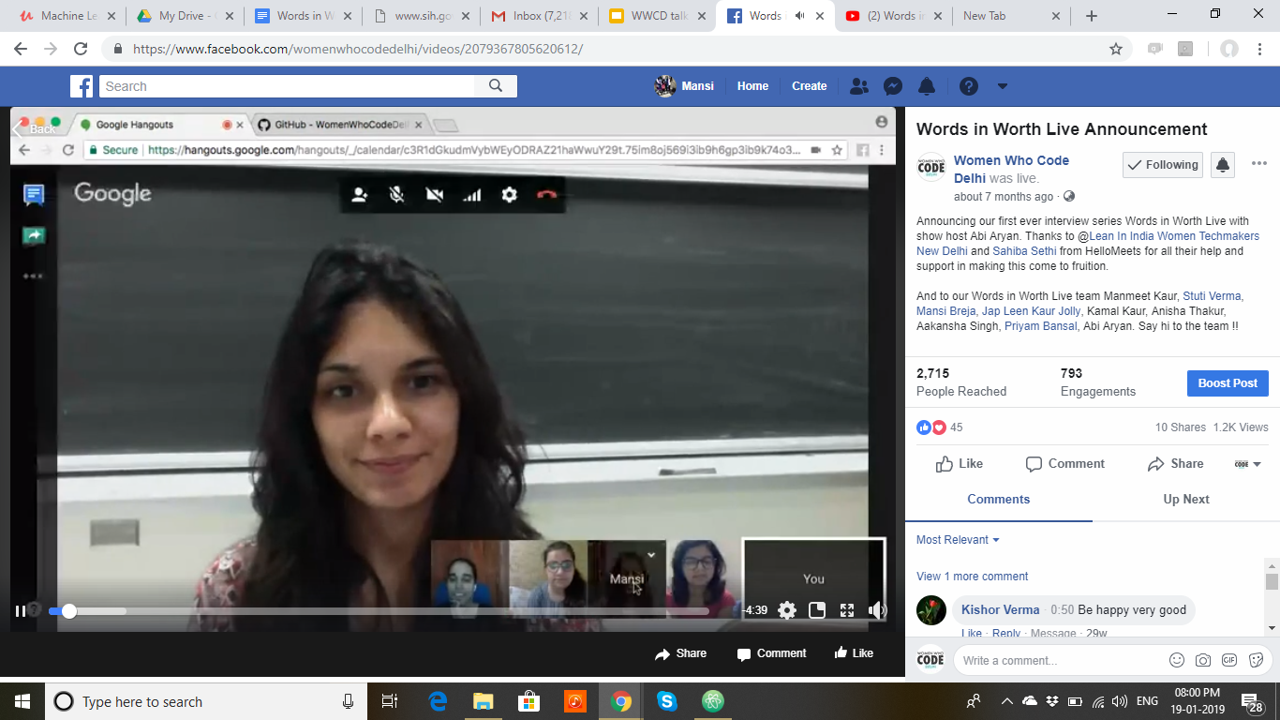

Slide 8
WHAT
I learnt?

Slide 9
Just do something, anything!
Never stop!
Do not think negative, coz thoughts create destiny!
Love yourself, feel proud of how far you’ve come and believe in yourself, that there is so much more, yet to come!

Slide 10
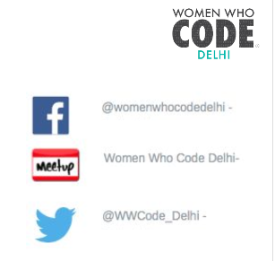
Share your ideas with us!
Join us!
You can reach out to us on Facebook, LinkedIn
or Twitter
It’s more about the initiative!

Slide 11
Thank you for your time!
:D

